Slide 1

They read in the book, The Law of God, making it clear with interpretation and giving the meaning so the people understood the reading (Neh. 8:8).
All Scripture taken from the English Unlocked Literal Bible (ULB), ©2017, 2022 Wycliffe Associates, Available at https://bibleineverylanguage.org/translations, licensed under the Creative Commons Attribution-ShareAlike 4.0 International License.
The English ULB is based on the unfoldingWord® Literal Text, CC BY-SA 4.0. The original work of the unfoldingWord® Literal Text is available at https://unfoldingword.bible/ult/.
Meaning-Based Translation

Slide 2


Literal vs. Meaning-Based Translation
Literal
Meaning-Based
Focus on restating each word in the source text, one by
one
Focus on translating the message of the source text so that its meaning is understood

Slide 3
Oral Interpretation
Original
message
Target
language
Meaning
Accurate = Same Meaning
Clear = Easy to Understand
Natural = Conversational Flow

Slide 4
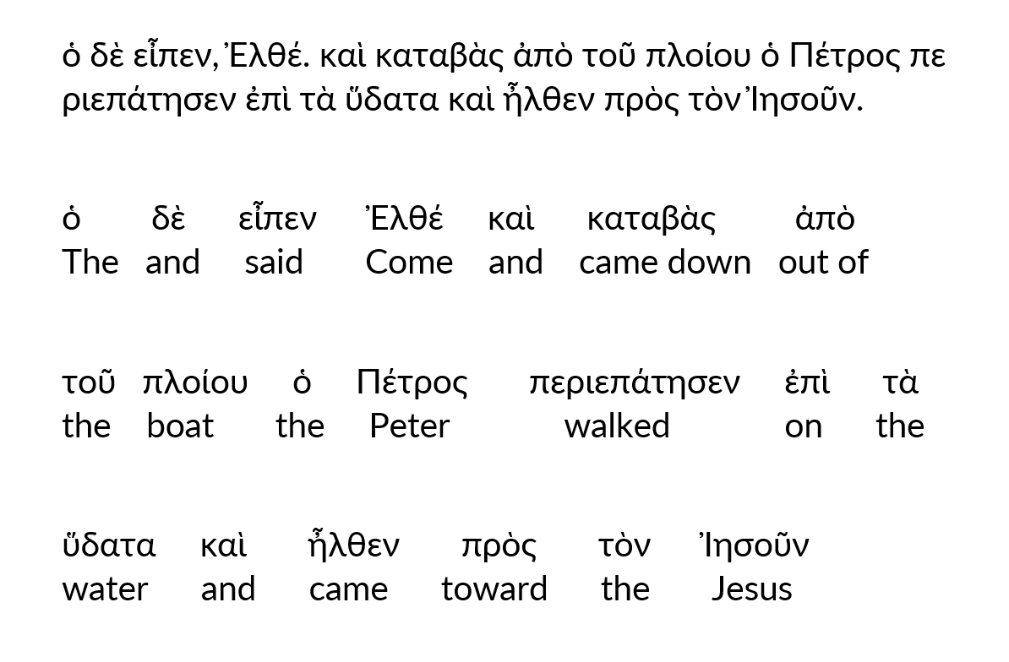
ὁ δὲ εἶπεν, Ἐλθέ. καὶ καταβὰς ἀπὸ τοῦ πλοίου ὁ Πέτρος περιεπάτησεν ἐπὶ τὰ ὕδατα καὶ ἦλθεν πρὸς τὸν Ἰησοῦν.

Slide 5
“I am very blessed to be here today.
By God’s grace and the power of the Holy Spirit, Scripture will be translated into our own tongue.”

